Slide 1
8th Grade MEAL PLANNING Principles (Foods Packet Page 24)
Learning Goal: To explore the four basic meal planning principles.

Slide 2
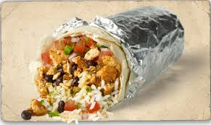
1. Meal Planning Principles:
1. Budget
2. Nutrition
3. Time
4. Meal Appeal

Slide 3
2. Budget
Every family has a food budget. Most families have to work hard to stay within their allotted food budget.
When trying to stretch food dollars, you could consider sale items, coupons, store-brand products, buying items in bulk, and utilizing leftovers when planning meals.

Slide 4
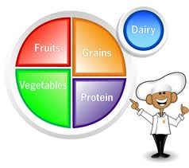
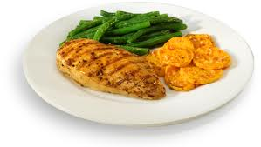
3. NUTRITION
Your health and well being is dependent on eating nutritious food.
TRY TO INCORPORATE EACH PART OF MYPLATE INTO ALL YOUR MEALS!
Focus on fresh fruits and vegetables, whole grains, and lean proteins.

Slide 5
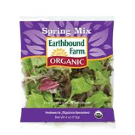
4. TIME
HAVING LITTLE TIME DOES NOT MEAN YOUR MEALS NEED TO BE “FAST FOOD”.
PLAN AHEAD OR USE CONVENIENCE FOODS.
PRECUT FRUIT/VEGETABLES
SALAD MIXES
MICROWAVES, CROCKPOTS, DISHWASHERS AND FOOD PROCESSORS CAN BE TIME SAVING TOOLS!

Slide 6
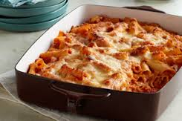
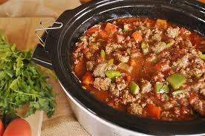
4. Time
MAKE MEALS AHEAD OF TIME
CROCKPOT
FREEZER
FAST COOKING METHODS
MICROWAVE
BROILING
ONE DISH MEALS
CASSEROLES

Slide 7
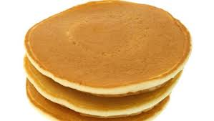
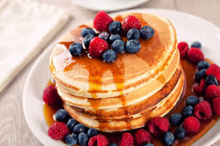
5. Which pancake is more appealing to you? Explain why.
B
A
VS.

Slide 8
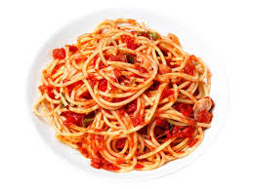
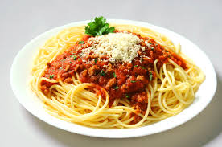
VS.
6. If you had to select one of these items, which one would you prefer? Why?
A
B

Slide 9
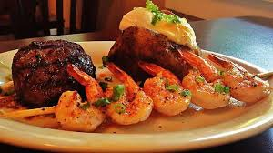
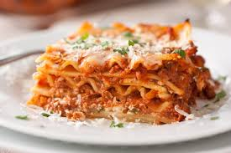
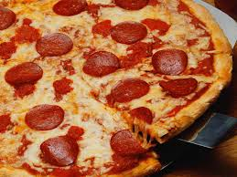
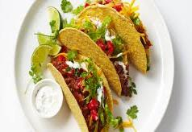
7. Imagine your favorite meal…
What is it?
Who made it?
Describe your favorite meal.

Slide 10
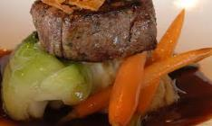
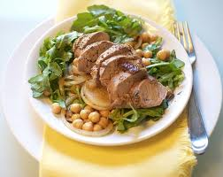
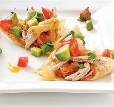
8. MEAL APPEAL CHARACTERISTICS
COLOR
SHAPE
FLAVOR
TEXTURE
TEMPERATURE

Slide 11
Meal Appeal Characteristics
Color- Combine different colors to make a meal interesting and vary the nutrients within the meal!
Shape- Contrasting shapes within a meal make it fun and appealing.
Flavor- Experiment with different flavors in a meal to stimulate the taste buds.

Slide 12
Meal Appeal Characteristics
Texture- All meals should include a variety of textures. The texture can vary from soft, crunchy, smooth or chewy.
Temperature- Serving food at various temperatures is another way to add appeal to a meal. A cool side salad with a warm meal is one way to vary the temperature.

Slide 13
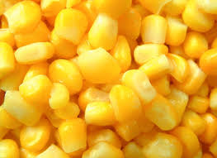
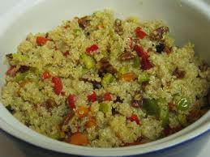
9. What is wrong with this meal?
Answer questions # 9-13 based on the Meal Appeal Characteristics.

Slide 14
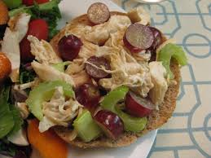
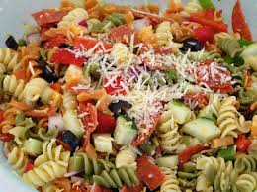
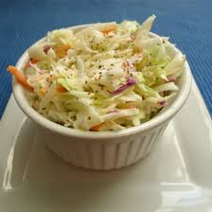
10. What is wrong with this meal?

Slide 15
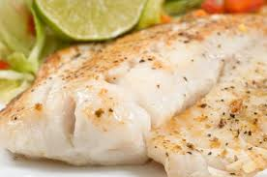
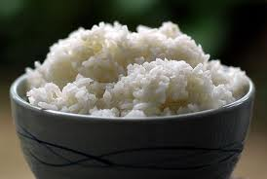
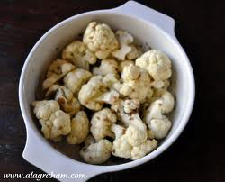
11. What is wrong with this meal?

Slide 16
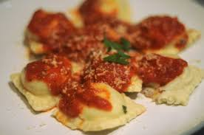
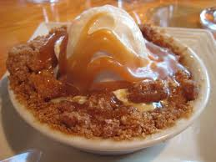
12.What is wrong with this meal?

Slide 17
13. What did you learn?
Two Sentence Summary:
Summarize what you learned about the meal planning principles in two sentences.

